Slide 1

Impact of Feed Rate and Electrolyte on Rene 41 Micro Drilling Using Electrochemical Micro Machining
Veera Venkata Sai Mahesh Prabhakar Reddi

Slide 2

OUTLINE:
INTRODUCTION
BACKGROUND OF RENE 41 ALLOY
EXPERIMENTAL DETAILS
FORMULAS USED
RESULTS AND DISCUSSION
REFERENCES

Slide 3
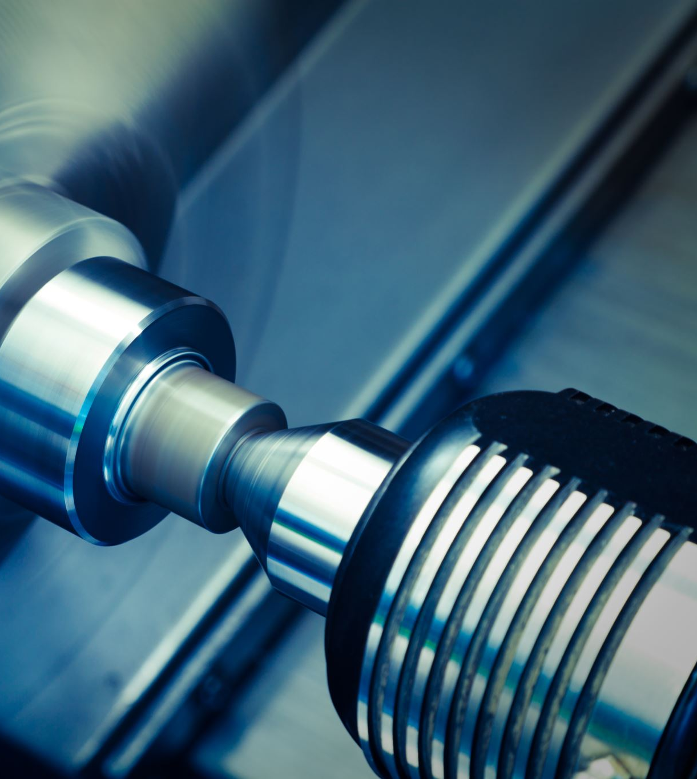
INTRODUCTION
Micro machining is a key method in the pursuit of precision manufacturing, as it addresses the urgent requirement for functional miniaturization in a variety of industries. With a primary goal of streamlining the micro drilling procedure for Rene 41, a strong high-temperature superalloy often used in aerospace and other industries, our research explores the complex dynamics of electrochemical micro machining (ECMM). Our goal is to uncover insights that have the potential to transform manufacturing processes and result in increased productivity, cost savings, and better component quality. We will do this by examining the complex link between electrolyte type, tool feed rate, and their effects on material removal rate and surface polish.

Slide 4

BACKGROUND OF RENE 41 ALLOY
Unmatched Strength and Thermal Stability:
Rene 41 is a key component of industrial machinery and vital aerospace propulsion systems due to its extraordinary strength and unrivaled thermal stability. Its ability to withstand high temperatures guarantees dependable and constant performance in a range of applications. Rene 41 Micro Drilling Optimization:
Our research explores the complex procedure of Rene 41 alloy-specific micro drilling optimization. We hope to increase drilling efficiency and precision by utilizing cutting-edge electrochemical micromachining processes, which will enable the alloy to reach its full potential in industrial and aerospace applications.

Slide 5
Applications in Aerospace and Industry:
The unique properties of Rene 41 alloy render it indispensable in aerospace propulsion systems, where its robustness and thermal stability are crucial for enduring extreme conditions. In the industrial sector, Rene 41 is essential for machinery and components that are exposed to high temperatures since it ensures their durability and good performance. Increasing technology boundaries:
We have made progress in expanding technology horizons with our investigation of micro drilling optimization for Rene 41. Our goal is to improve performance, reliability, and operational efficiency in the aerospace and industrial sectors by refining drilling procedures that are specific to the properties of this alloy.

Slide 6
EXPERIMENTAL DETAILS
Our experimental setup for investigating Rene 41 micro drilling was meticulously designed to simulate real-world conditions accurately. We evaluated two electrolytes, sodium nitrate (NaNO3) and sodium bromide (NaBr), and varied the supply rate across three levels using a table-mounted TTECM-10 model micro machine and cylindrical copper-based hollow electrodes. Our workpiece matched the proportions of aerospace components, measuring 50 mm in length, 30 mm in width, and 200 microns in thickness.
Our goal was to investigate the nuances of surface finish and material removal rate while preserving consistency in other input parameters. The 500-micron-diameter tool electrode guaranteed accurate drilling. Our configuration is shown in Fig. 1, and Table 2 provides a summary of the individual machine details.

Slide 7
TABLE 1. Process parameter details
Process Parameters |  | Levels
Electrolyte | Nacl |  | Nabr
Rate of Feed(mm/min) | 0.5 | 0.6 |  | 0.7
Voltage(Volts) | 15 | 15 |  | 15
Pulse on time Ton (µs) | 10 | 10 |  | 10
Pulse off time Toff (µs) | 7 | 7 |  | 7

Slide 8
TABLE 2. Details of TTECM – 10 Machine
Machine Parameter | Details
Voltage | 1- 30 V
Current | 0 – 3 Amps
Motor Spindle | 300 – 3000 rpm BLDC Motor
Spindle type | ER 11 Collet type
Work table size | 260 X 110 X 100 mm
Maximum travel | 130 X 75 X 75 mm

Slide 9
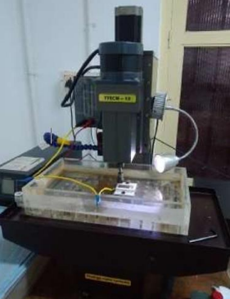
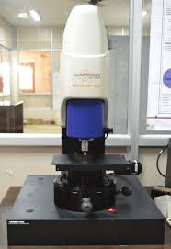
FIGURE 1. Machine Setup used
FIGURE 2.Talysurf CCI lite surface tester

Slide 10
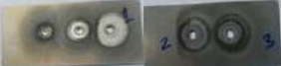
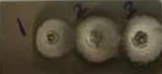
TABLE 3.Sample Specimens drilled
Electrolyte Used | Sample Work-Piece
NaBr
NaNo3
The micro drilled sample workpieces were subjected to detailed analysis to assess their rate of material removal and surface finish. The examination of surface finish was carried out utilizing the advanced interferometer Talysurf CCI light, as seen in Figure 2. The surface qualities were precisely characterized by means of rigorous measurement made possible by the use of miran objectives with a 20X magnification.

Slide 11
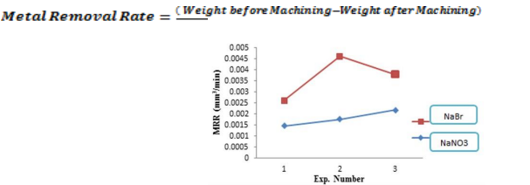
Results and Discussion
Equations 1 and 2 were employed for calculating material removal rates, with specimen weights measured before and after machining using an electronic micro weighing scale. Figure 3 illustrates that sodium bromide (NaBr), with its non-passivating nature, yields a higher material removal rate compared to sodium nitrate (NaNO3), attributed to the absence of surface layer formation, thus simplifying and expediting material removal. Moreover, increasing feed rates are associated with higher material removal rates, particularly pronounced with NaBr, albeit reaching a plateau at higher feed rates. Surface finish assessment was conducted using a non-contact surface roughness instrument, with results presented in Table 4. Three-dimensional representations of micro-drilled surfaces machined at a feed rate of 0.6 mm/min using NaNO3 and NaBr electrolytes are depicted in Figures 4(a) and (b), respectively.
FIG 3. Effect of Electrolyte and feed rate on MRR

Slide 12
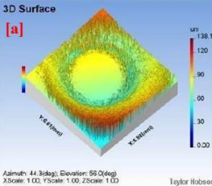
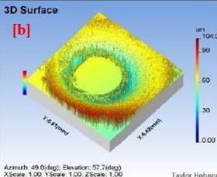
FIGURE 4. 3D view of Machined surface a) NaNo3 Electrolyte used b) NaBr Electrolyte used.

Slide 13
TABLE 4. Surface roughness values of the micro drilled holes
Electrolyte Type | Ra(µm) | Rt(µm) | Rq(µm) | Rp(µm) | Rv(µm) | Rz(µm)
NaNO3 | 3.5 | 55 | 4.8 | 8.2 | 11.5 | 21
NaBr | 1.8 | 28 | 2.3 | 5.2 | 3.9 | 10
The specimens machined with NaNO3 and NaBr were found to have surface roughness values of roughly 4.5 µm and 1.6 µm, respectively, after machining. The application of NaNO3 during the machining of Rene 41 led to a relatively worse surface finish because it was unable to effectively control stray corrosion.

Slide 14
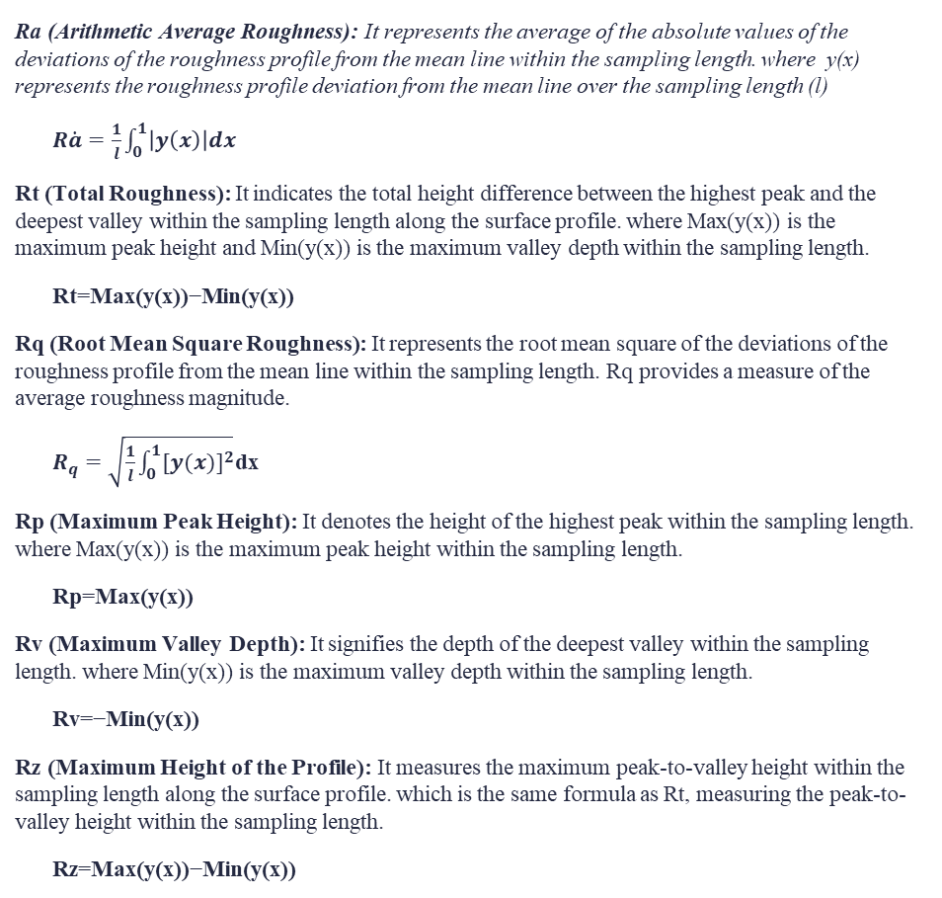
FORMULAS
Ra (Arithmetic Average Roughness): It represents the average of the absolute values of the deviations of the roughness profile from the mean line within the sampling length. where y(x) represents the roughness profile deviation from the mean line over the sampling length (l)
$R\dot{a}=\frac{1}{l}\int_{0}^{1}{\left|y\left(x\right)\right|dx}$
Rt (Total Roughness): It indicates the total height difference between the highest peak and the deepest valley within the sampling length along the surface profile. where Max(y(x)) is the maximum peak height and Min(y(x)) is the maximum valley depth within the sampling length.
Rt=Max(y(x))−Min(y(x))
Rq (Root Mean Square Roughness): It represents the root mean square of the deviations of the roughness profile from the mean line within the sampling length. Rq provides a measure of the average roughness magnitude.
$R_{q}=\sqrt{\frac{1}{l}\int_{0}^{1}{{[y(x)]}^{2}}}$dx
Rp (Maximum Peak Height): It denotes the height of the highest peak within the sampling length. where Max(y(x)) is the maximum peak height within the sampling length.
Rp=Max(y(x))
Rv (Maximum Valley Depth): It signifies the depth of the deepest valley within the sampling length. where Min(y(x)) is the maximum valley depth within the sampling length.
Rv=−Min(y(x))
Rz (Maximum Height of the Profile): It measures the maximum peak-to-valley height within the sampling length along the surface profile. which is the same formula as Rt, measuring the peak-to-valley height within the sampling length.
Rz=Max(y(x))−Min(y(x))
Using a stylus or a laser probe to trace the machined component's surface profile, these values are then determined by examining the deviations from the ideal reference line or surface. The roughness parameters are calculated statistically using the deviations that the equipment captures at various spots along the surface.To determine the corresponding roughness parameters, these formulas require integrating or evaluating the roughness profile y(x) over a certain sampling length l.

Slide 15
CONCLUSION
"In conclusion, two distinct electrolytes—NaBr and NaNO3—and a three-level feed rate variation were used to perform Rene 41 microdrilling. Following an analysis of the experiment's findings, the following findings were made:
When compared to the passivating NaNO3 electrolyte, the non-passivating NaBr electrolyte demonstrated a higher rate of material removal. The fact that NaBr did not develop a surface layer on Rene 41 allowed for rapid and effective removal of material.
On the other hand, when Rene 41 was machined with NaNO3, there was a lot of stray corrosion, which caused the surface to be rougher than when NaBr electrolyte was used.

Slide 16
REFERENCES
1. K.G.Saravanan, R.Prabu, A.R.Venkataramanan, and Eden TekleBeyessa, “Impact of different electrolytes on the machining rate in ECM process”, Advances in Material science and Engineering, Volume 2021, https://doi.org/10.1155/2021/1432300
2. Krishna Kumar saxena, JunQian, Dominiek Reynaerts, “A review on process capabilities of electrochemical micromachining and its hybrid Varients”, International Journal of Machine tools and Manufacture, 127 (2018) 28-56.
3. D.S. Bilgi, V.K. Jain, R. Shekhar, S. Mehrotra, Electrochemical deep hole drilling in super alloy for turbine application, Journal of Material Processing Technology. 149 (1–3) (2004) 445–452.
4. L.Yong, H.Ruiqin, Micro electro chemical machining for tapered holes of fuel jet nozzles, Procedia CIRP6(ISEMXVII) (2013)395–400.
5. M. Datta, L.T. Romankiw, Application of chemical and electrochemical micromachining in the electronics industry, Journal of Electrochemical Society. 136 (6) (1989) 285C–292C.
6. A.B. Kamaraj, M.M. Sundaram, R. Mathew, Ultra high aspect ratio penetrating metal micro electrodes for biomedical applications, Microsystem Technology, 19 (2) (2013) 179–186.

Slide 17

THANK YOU

